Slide 1



Towards the Tangible: Microtonal Scale Exploration in Central-African Music

Slide 2
OUTLINE
Introduction
  Background
  Dataset
  Context Analysis
Methodology
Tarsos
  Demo
Conclusions & Opportunities

Slide 3
INTRODUCTIONBACKGROUND
Research 'team' based at the School of Arts Ghent in Belgium:
Joren Six, Computer Scientist
Olmo Cornelis, Musicologist & Composer
We approach ethnomusicology with a computational approach:
Computational Ethnomusicology[1]

Slide 4
INTRODUCTIONDATASET
Digitization project “Digitization of the Ethnomusicological Sound Archive of the Royal Museum for Central Africa” resulted in:
    Audio: 50.000 sound recordings – 3.000 hours of music - 33.000 items digitized.
    Contextual Meta-data : 35.000 items digitized
    Development of a website: http://music.africamusem.be
    Preliminary exploration of MIR-techniques.

Slide 5
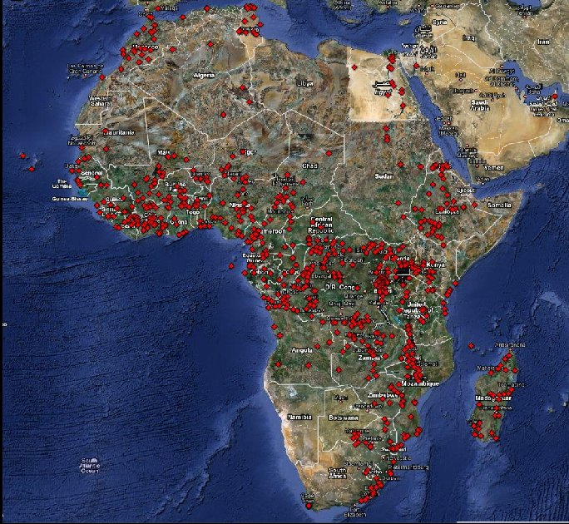
INTRODUCTIONDATASET

Slide 6
INTRODUCTIONCONTEXT ANALYSIS
Goal of our current research project:
Provide culture independent access to archives with ethnic music that deal with a large variability of musical content, users, search intentions and expectations in a multidisciplinary approach, combining musicology and computational means.

Slide 7
INTRODUCTIONCONTEXT ANALYSIS
Opportunities
Document musical diversity
New Comparative Musicology [Steven Brown]
Spot trends and influences
Use interesting features in new compositions

Slide 8
METHODOLOGY
Develop a method yielding culture independent views on musical parameters by using or adapting existing signal processing MIR-techniques.
This idea is implemented in the software package Tarsos[5]: An easy to use, open system to extract and explore pitch organization in musical audio for scientific, educational and artistic purposes.
Temporal and timbral features follow

Slide 9
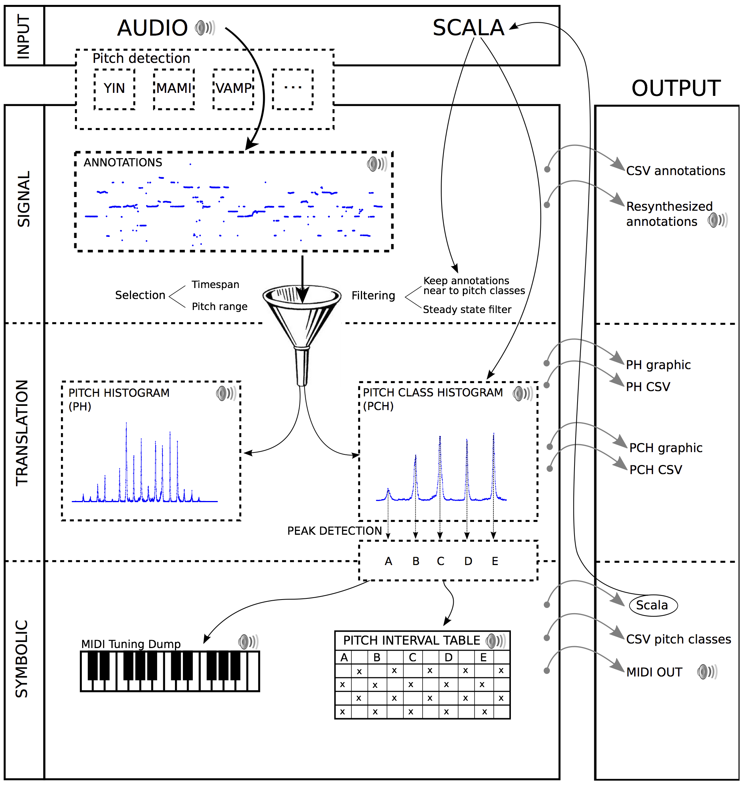
METHODOLOGYTARSOS BLOCK DIAGRAM

Slide 10
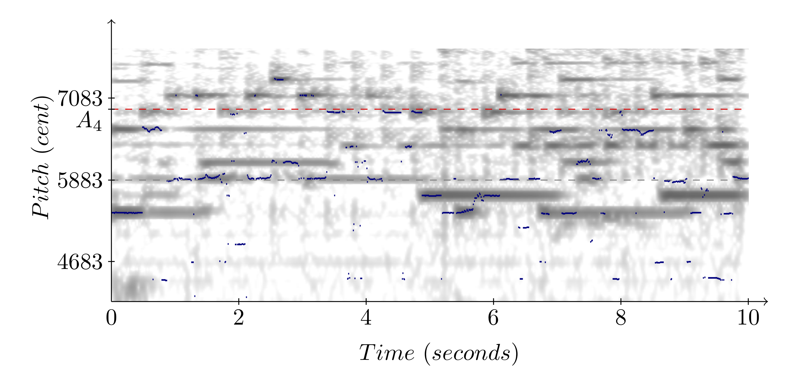
METHODOLOGYTARSOS BLOCK DIAGRAM

Slide 11
METHODOLOGYTARSOS BLOCK DIAGRAM

Slide 12
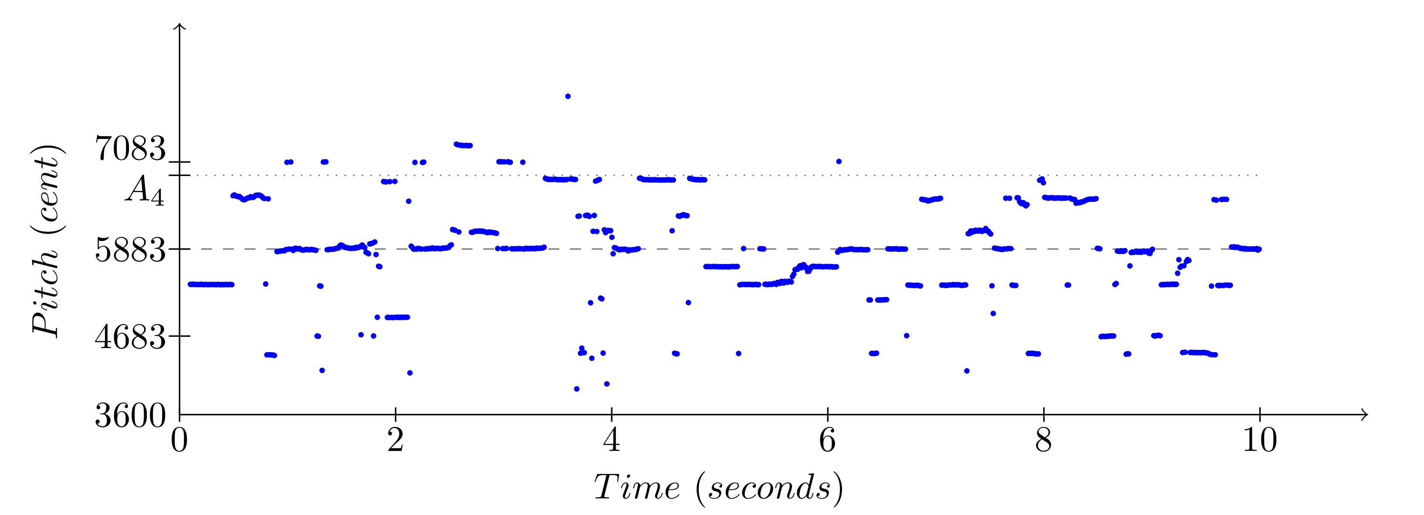
METHODOLOGYTARSOS BLOCK DIAGRAM

Slide 13
METHODOLOGYTARSOS BLOCK DIAGRAM

Slide 14
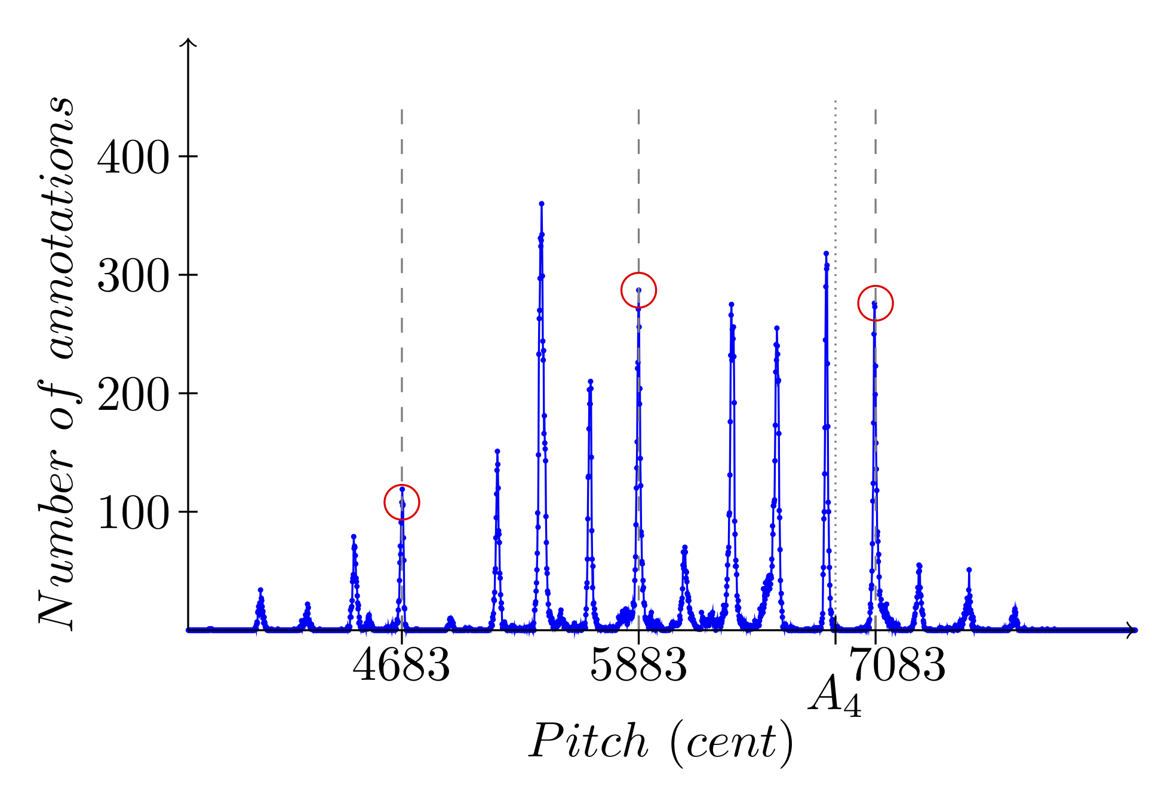
METHODOLOGYTARSOS BLOCK DIAGRAM

Slide 15
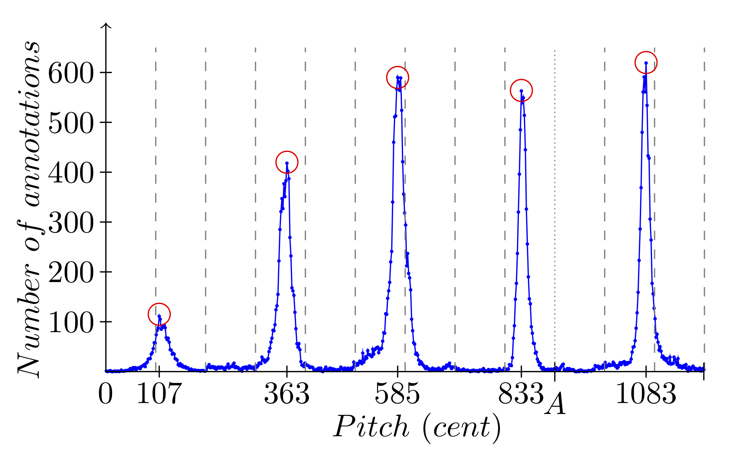
METHODOLOGYTARSOS BLOCK DIAGRAM

Slide 16
METHODOLOGYTARSOS BLOCK DIAGRAM

Slide 17
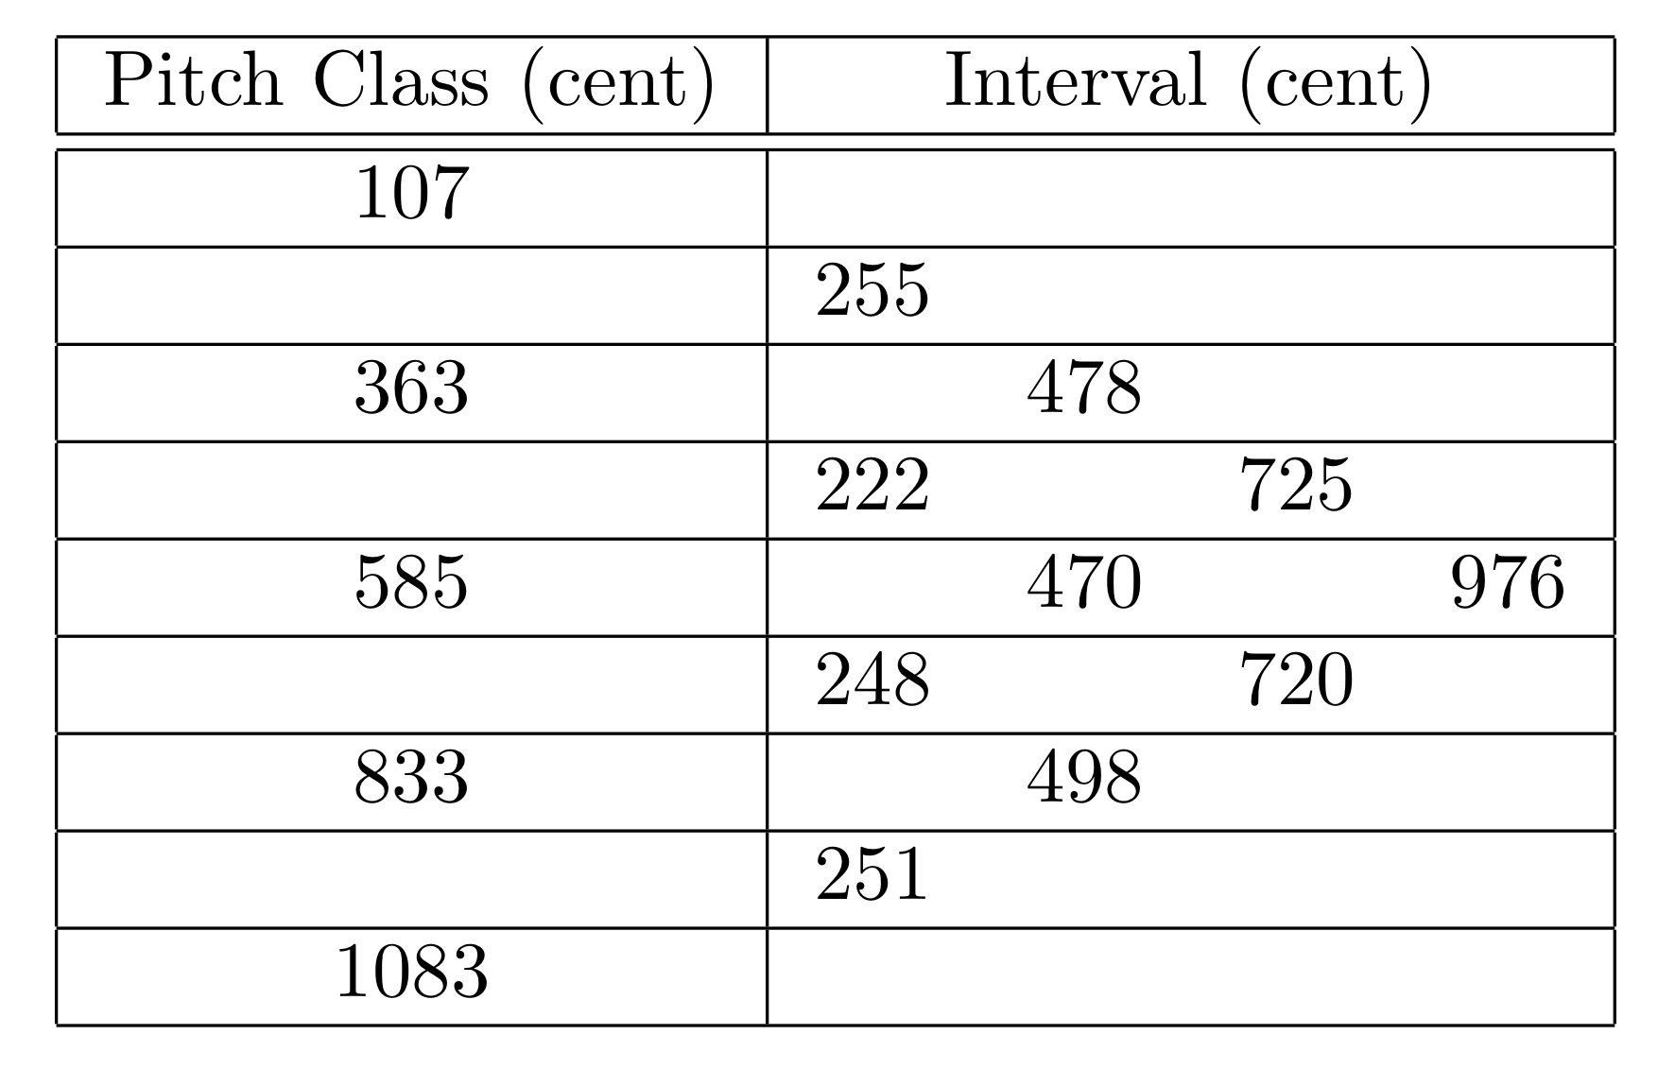

METHODOLOGYTARSOS BLOCK DIAGRAM
MIDI Tuning Dump

Slide 18

TARSOSDEMO

Slide 19
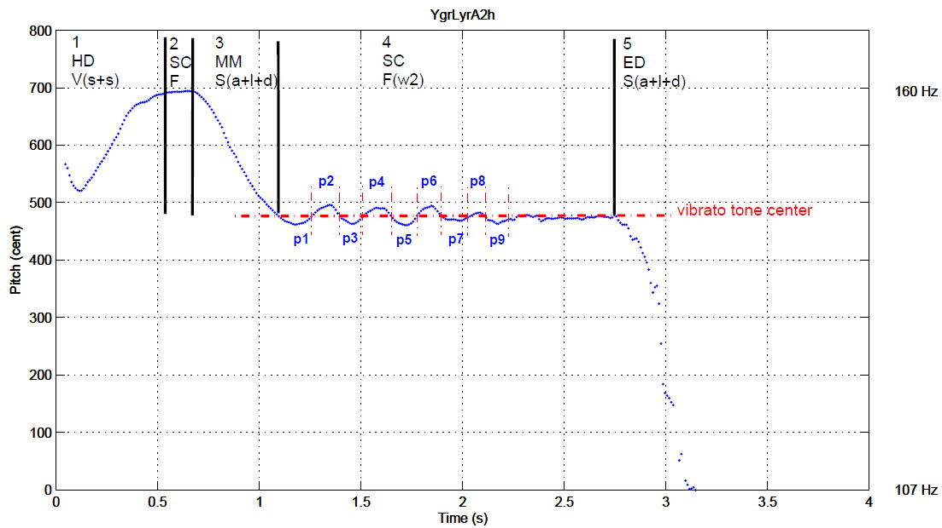
TARSOSPitfalls
What is a note?

Slide 20
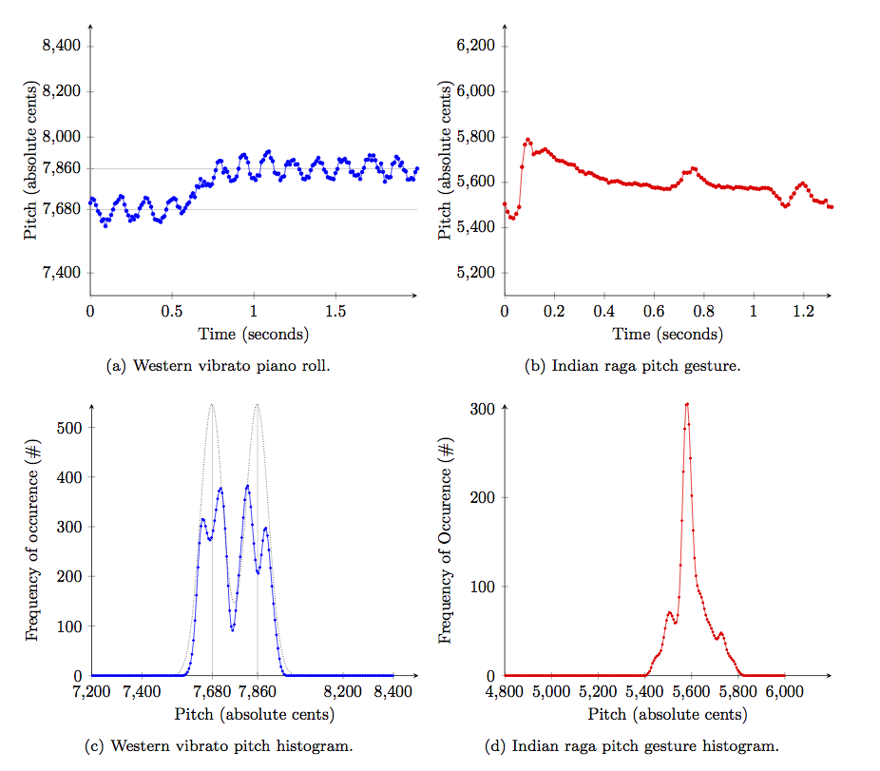
TARSOSPitfalls
What is a note?

Slide 21
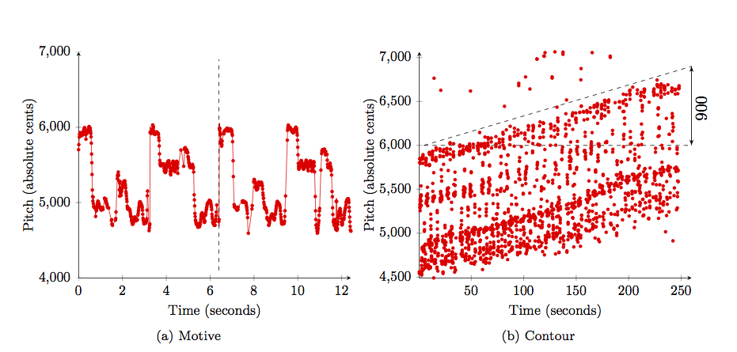
TARSOSPitfalls
What is a tone scale?

Slide 22
TARSOSAPI
Scripting API:
Search for pitch intervals
Tone scale (makam, raga) recognition
Audio fingerprinting [4]
Scripting possible with any JVM language:
  Scala
  Groovy
  Jython
  ...

Slide 23
CONCLUSIONS
Tarsos delivers:
  Scientific data
  - Historical temperaments.
  - African tone scales are becoming more western like[3]
  Artistic input e.g. experimentation with microtonal compositions.
  Educational opportunities: improve intonation.

Slide 24
DISCLAIMER
Audio alone might not be sufficient to describe and/or retrieve ethnic music:
What does it mean to search and retrieve music from a culture where the word “music” exists only in connection to body movement, smell, taste, colour.
The idea of separating sound from the rest of its physical environment (movement, smell, taste, colour) may well be a weird “invention” of the West.
We cannot understand ethnic music correct without its social function and context![2]

Slide 25
CONTACT
joren.six@hogent.be
olmo.cornelis@hogent.be
http://tarsos.0110.be
http://music.africamuseum.be

Slide 26
References
[1] G. Tzanetakis, A. Kapur, W. A. Schloss, M. Wright. Computational Ethnomusicology. Journal of Interdisciplinary Music Studies, 2007.
[2] Access to ethnic music: Advances and perspectives in content-based music information retrieval - Cornelis, O., Lesaffre, M., Moelants, D. & Leman, M. Apr-2010 In : Signal Processing. 90, 4, p. 1008-1031. 24 p.
[3] Moelants,D.,Cornelis,O.,Leman,M.:Exploring african tone scales. Proceedings of 9th ISMIR Conference (2009)
[4] Six, J. & Cornelis O. A Robust Audio Fingerprinter Based on Pitch Class Histograms - Applications for Ethnic Music Archive, Proceedings Folk Music Analysis conference 2012
[5] Six, J. & Cornelis, O., Tarsos - a Platform to Explore Pitch Scales in Non-Western and Western Music, 24-Oct-2011 Proceedings of the 12th International Society for Music Information Retrieval Conference, ISMIR 2011.

Slide 27
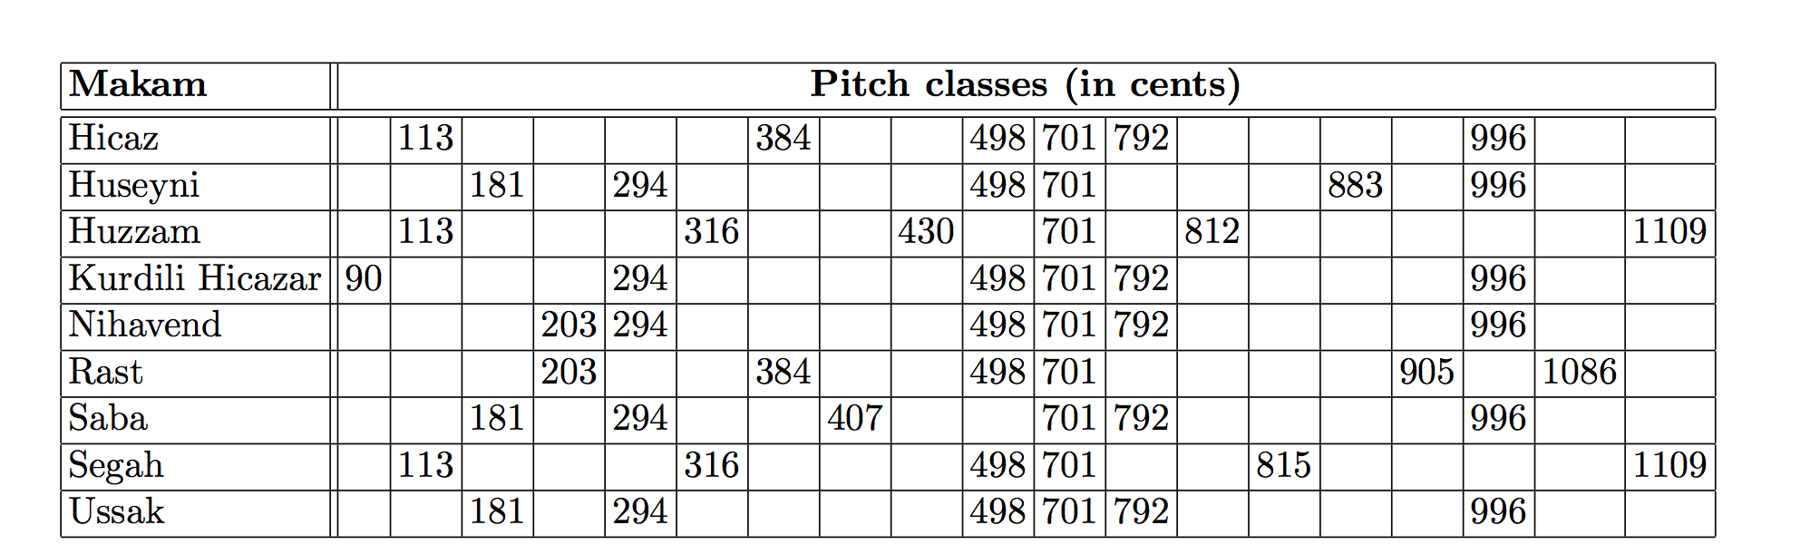
MAKAM RECOGNITION

Slide 28
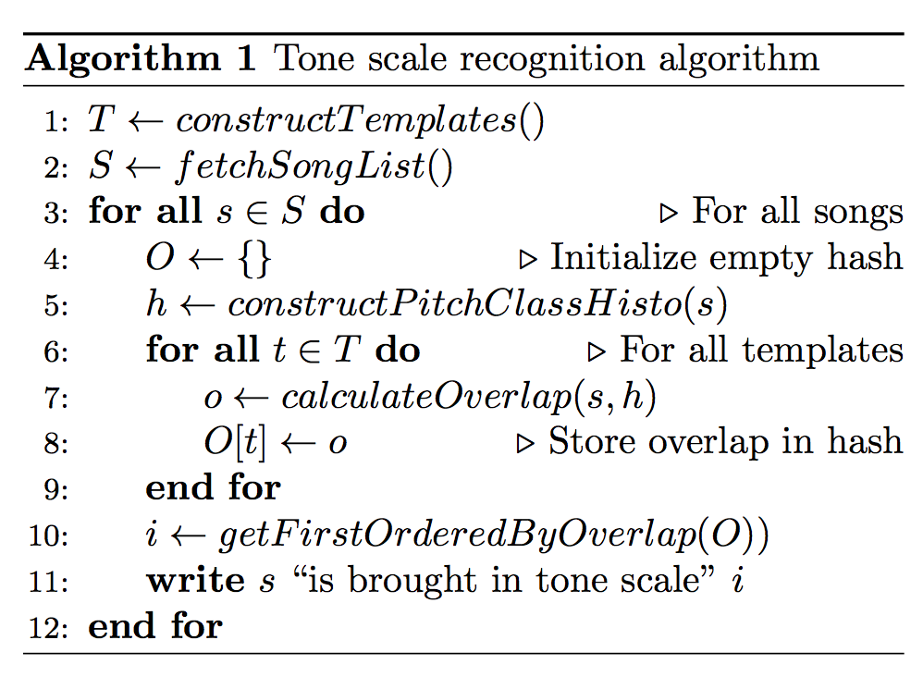
MAKAM RECOGNITION

Slide 29
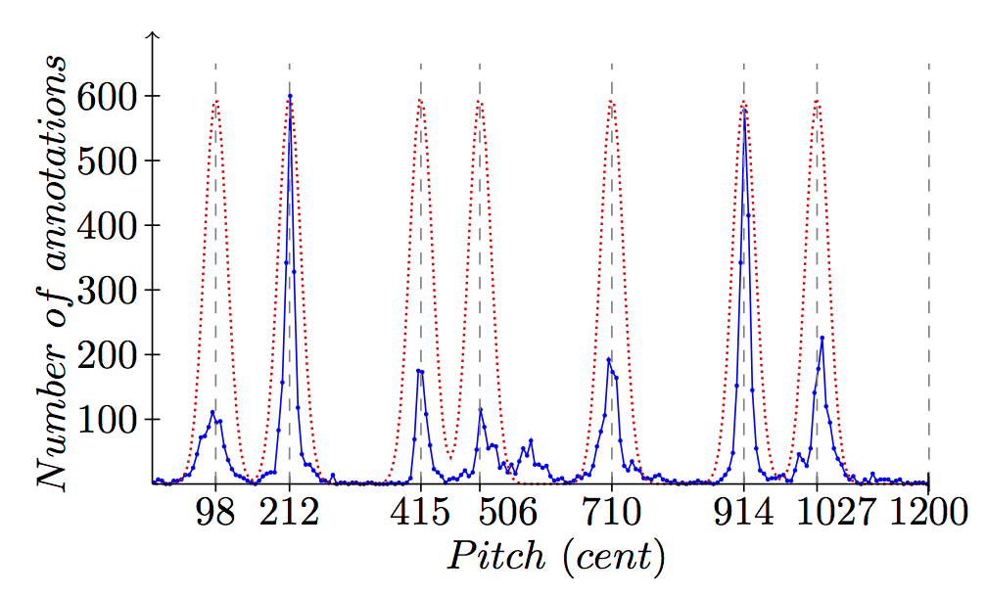
MAKAM RECOGNITION

Slide 30
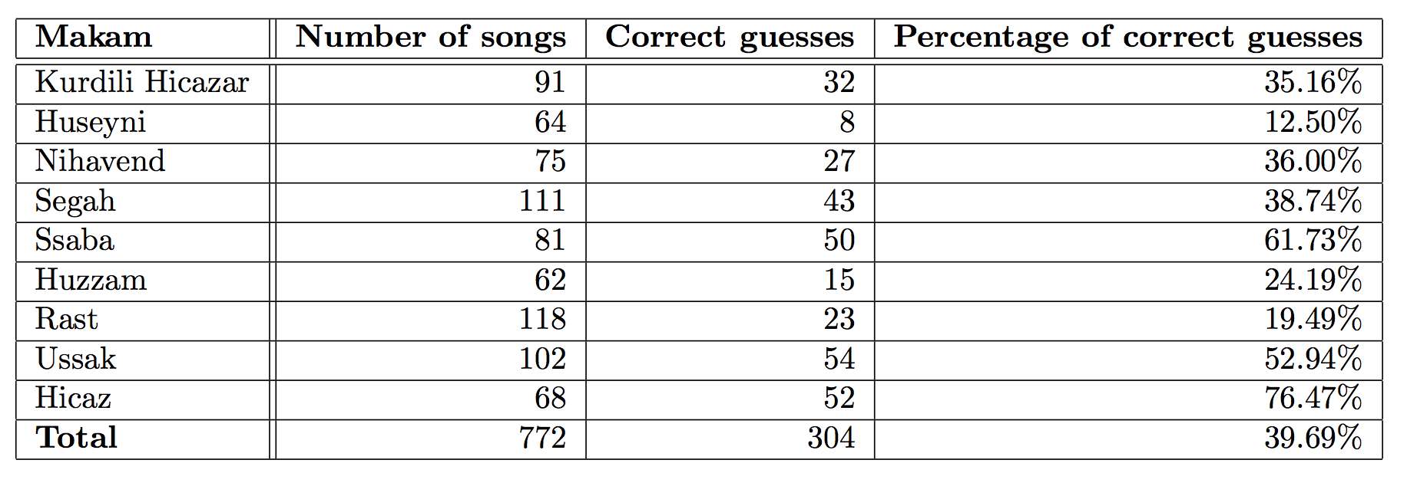
MAKAM RECOGNITION

